Slide 1
Unit-IV Semantic Analyzer and Intermediate Code Generation

Slide 2
Syntax-Directed Definitions and Translation Schemes
When we associate semantic rules with productions, we use two notations:
Syntax-Directed Definitions
Translation Schemes
Syntax-Directed Definitions:
give high-level specifications for translations
hide many implementation details such as order of evaluation of semantic actions.
We associate a production rule with a set of semantic actions, and we do not say when they will be evaluated.
Translation Schemes:
indicate the order of evaluation of semantic actions associated with a production rule.
In other words, translation schemes give a little bit information about implementation details.

Slide 3
Syntax-Directed Definition
A syntax-directed definition(SDD) is a generalization of a context-free grammar in which:
Each grammar symbol is associated with a set of attributes.
This set of attributes for a grammar symbol is partitioned into two subsets called synthesized and inherited attributes of that grammar symbol.
Each production rule is associated with a set of semantic rules.
Semantic rules are used for computing values of the attributes associated with the symbols appearing in that production.
Semantic rules set up dependencies between attributes which can be represented by a dependency graph.
This dependency graph determines the evaluation order of these semantic rules.
The grammar and set of semantic rules constitute the syntax directed definition.

Slide 4
Annotated Parse Tree
A parse tree showing the values of attributes at each node is called an annotated parse tree.
The process of computing the attributes values at the nodes is called annotating (or decorating) of the parse tree.

Slide 5
Synthesized Attributes
An attribute is said to be Synthesized if its value at a parse tree node is determined from attribute values at the child nodes.
To illustrate, assume the following production S → ABC if S is taking values from its child nodes (A, B, C), then it is said to be a synthesized attribute, as the values of ABC are synthesized to S.
The production must have non-terminal as its head.
It can be evaluated during a single bottom-up traversal of the parse tree.
A syntax directed definition that uses only synthesized attributes is said to be an S-attributed definition.

Slide 6
SDD - Synthesized Attributes- Example
Production Semantic Rules
L → E n print(E.val)
E → E₁ + T E.val = E₁.val + T.val
E → T E.val = T.val
T → T₁ * F T.val = T₁.val * F.val
T → F T.val = F.val
F → ( E ) F.val = E.val
F → digit F.val = digit.lexval
Symbols E, T, and F are associated with a synthesized attribute val.
The token digit has a synthesized attribute lexval (it is assumed that it is evaluated by the lexical analyzer).

Slide 7
Annotated ParseTree for 2+3*4n

Slide 8
Dependency Graph
Input: 5+3*4
L
E.val=17
E.val=5 T.val=12
T.val=5 T.val=3 F.val=4
F.val=5 F.val=3 digit.lexval=4
digit.lexval=5 digit.lexval=3

Slide 9
Inherited Attributes
An attribute is said to be Inherited if its value at a parse tree node is determined by the attribute value at parent and/or siblings node.
In case of S → ABC if A can get values from S, B and C. B can take values from S, A, and C. Likewise, C can take values from S, A, and B then S is said to be Inherited Attribute.
The production must have non-terminal as a symbol in its body.
It can be evaluated during a single top-down and sideways traversal of parse tree.

Slide 10
Syntax-Directed Definition – Inherited Attributes
Production Semantic Rules
D → T L L.in = T.type
T → int T.type = integer
T → real T.type = real
L → L₁ , id L₁.in = L.in, addtype(id.entry,L.in)
L → id addtype(id.entry,L.in)
Symbol T is associated with a synthesized attribute type.
Symbol L is associated with an inherited attribute in.

Slide 11
Annotated ParseTree
Example real id₁, id₂ , id₃
D
addtype(id₃,real)
L
in=real
addtype(id₂,real)
L
in=real
T
type=real
addtype(id₁,real)
L
in=real
id
entry=id₁
,
id
entry=id₂
,
id
entry=id₃
real

Slide 12
Dependency Graph
in=real
dummy
in=real
dummy
T
type=real
in=real
dummy
id
entry=id₁
id
entry=id₂
id
entry=id₃

Slide 13
Syntax Directed Translation(SDT)
In a syntax-directed definition, we do not say anything about the evaluation times of the semantic rules (when the semantic rules associated with a production should be evaluated?).
A translation scheme(SDT) is a context-free grammar in which:
attributes are associated with the grammar symbols and
semantic actions enclosed between braces {} are inserted within the right sides of productions.
Ex: A → { ... } X { ... } Y { ... }
Semantic Actions

Slide 14
Translation Schemes
When designing a translation scheme, some restrictions should be observed to ensure that an attribute value is available when a semantic action refers to that attribute.
These restrictions (motivated by L-attributed definitions) ensure that a semantic action does not refer to an attribute that has not yet computed.
In translation schemes, we use semantic action terminology instead of semantic rule terminology used in syntax-directed definitions.
The position of the semantic action on the right side indicates when that semantic action will be evaluated.

Slide 15
Translation Schemes for S-attributed Definitions
If our syntax-directed definition is S-attributed, the construction of the corresponding translation scheme will be simple.
Each associated semantic rule in a S-attributed syntax-directed definition will be inserted as a semantic action into the end of the right side of the associated production.
Production Semantic Rule
E → E₁ + T E.val = E₁.val + T.val ➔ a production of
a syntax directed definition
⇓
E → E₁ + T { E.val = E₁.val + T.val } ➔ the production of the corresponding
translation scheme

Slide 16
Inherited Attributes in Translation Schemes
If a translation scheme has to contain both synthesized and inherited attributes, we have to observe the following rules:
An inherited attribute of a symbol on the right side of a production must be computed in a semantic action before(left of) that symbol.
A synthesized attribute for the non-terminal on the left side of the production should be placed at the end of the right side of the production.

Slide 17
A Translation Scheme with Inherited Attributes
D → T {L.in = T.type } L
T → int { T.type = integer }
T → real { T.type = real }
L → {L₁.in = L.in } L₁ , id {addtype(id.entry,L.in)}
L → id {addtype(id.entry,L.in)}
This is a translation scheme for an L-attributed definitions.

Slide 18
SDD for infix to prefix translation
SDT for infix to postfix translation
Production Semantic Rule
E → E₁ + T E.pre :=‘+’ || E₁.pre || T.pre
E → T E.pre := T.pre
T → T₁ * F T.pre :=‘*’ || T₁.pre || F.pre
T → F T.pre := F.pre
F → (E) F.pre := E.pre
F → num F.pre := num.lval
F → 0 F.pre := ‘0’
|| - concatenation
Production Semantic Rule
E → E₁ + T { print(‘+’) }
E → T { }
T → T₁ * F { print(‘*’) }
T → F { }
F → (E) { }
F → num {print(num.lval)}
F → 0 {print(‘0’)}
F → 1 {print(‘1’)}
SDD Postfix: SDT Postfix:
E.post := E₁.post || T.post || ‘+’ E → E₁ + T { print(‘+’)}
SDD Prefix: SDT Prefix:
E.pre := ‘+’ || E₁.pre || T.pre E → { print(‘+’) } E₁ + T

Slide 19
SDT for infix to postfix translation(TDP)
E
E → E + T { print(‘+’) }
E → T { }
T → T * F { print(‘*’) }
T → F { }
F → (E) { }
F → num {print(num.lval)}
Example: 2+3*4
E + T 1
T 2 T * F 3
F 4 F 4 num 6
4
num 6 num 6
2 3
234*+

Slide 20
SDT for infix to postfix translation(BUP)
E
E → E + T { print(‘+’) }
E → T { }
T → T * F { print(‘*’) }
T → F { }
F → (E) { }
F → num {print(num.lval)}
Example: 2+3*4
E + T
T T * F
F F num
4
num num
2 3
234*+

Slide 21
Attribute Grammar
So, a semantic rule b=f(c₁,c₂,…,c_{n}) indicates that the attribute b depends on attributes c₁,c₂,…,c_{n}.
In a syntax-directed definition, a semantic rule may just evaluate a value of an attribute or it may have some side effects such as printing values.
An attribute grammar is a syntax-directed definition in which the functions in the semantic rules cannot have side effects (they can only evaluate values of attributes).

Slide 22
S-Attributed Definition
If an SDD uses only synthesized attributes, it is called as S-attributed.
Semantic actions are placed at right end of production.
A->XYZ{ }
Attributes are evaluated in bottom-up parsing, as the values of the parent nodes depend upon the values of the child nodes.
A->BCD
A.s=f(B.s,C.s,D.s)

Slide 23
L-Attributed Definition
It uses both synthesized attributes and inherited attributes. Each inherited attribute restricted to inherit values either from parent or left siblings only.
Example:
A -> XYZ {Y.S = A.S, Y.S = X.S, Y.S = Z.S} is not an L-attributed grammar since
Y.S = A.S and Y.S = X.S are allowed but Y.S = Z.S violates the L- attributed SDT definition as attributed is inheriting the value from its right sibling.
Semantic actions are placed anywhere in RHS.
A->{ }BC
|D{ }E
|FG{ }
Attributes are evaluated by traversing parse tree depth-first and left-to-right manner.
If a definition is S-attributed, then it is also L-attributed but NOT vice-versa.

Slide 24
1)
Productions Semantic Rules
A → L M L.in=f(A.in), M.in=f(L.s), A.s=f(M.s)
A → Q R R.in=f(A.in), Q.in=f(R.in), A.s=f(Q.s)
a)S-attr b)L-attr c)both d)none
Answer: d
2)
A → BC {B.s=A.s}
a)S-attr b)L-attr c)both d)none
Answer: b

Slide 25
Write a S-attributed grammar to connect the following grammar with prefix operator,
L → E
E → E + T | E – T | T
T → T * F | T / F | F
F → F ↑ P | P
P → (E) | id
Production Semantic Rules
L → E L.pre := E.pre
E → E + T E.pre :=‘+’ || E.pre || T.pre
E → E - T E.pre :=‘-’ || E.pre || T.pre
E → T E.pre := T.pre
T → T * F T.pre :=‘*’ || T.pre || F.pre
T → T / F T.pre :=‘/’ || T.pre || F.pre
T → F T.pre := F.pre
F → F ↑ P F.pre :=‘↑’ || F.pre || P.pre
F → P F.pre := P.pre
P → (E) P.pre := E.pre
P → id P.pre := id.lexval
F → 0 F.pre := ‘0’

Slide 26
Example
List of bits count 1’s count 0’s count all bits
N → L {N.c=L.c} {N.c=L.c} {N.c=L.c}
L → L₁B {L.c=L₁.c+B.c} {L.c=L₁.c+B.c} {L.c=L₁.c+B.c}
L → B {L.c=B.c} {L.c=B.c} {L.c=B.c}
B → 0 {B.c=0} {B.c=1} {B.c=1}
B → 1 {B.c=1} {B.c=0} {B.c=1}

Slide 27
Write a Syntax Directed Definition to convert the given binary number with its decimal equivalent.
N
N
N→L {N.dval=L.dval}
L→L₁B {L.dval=L₁.dval * 2 + B.dval}
L→B {L.dval=B.dval}
B→0 {B.dval=0}
B→1 {B.dval=1}
Example: 1011
L
L
L B
1
L B
1
L B
1
L B
1
L B
0
L B
0
B
1
B
1

Slide 28
Intermediate Code Generation

Slide 29
Intermediate Code Generation
Intermediate codes are machine independent codes, but they are close to machine instructions.
The given program in a source language is converted to an equivalent program in an intermediate language by the intermediate code generator.
Types of Intermediate codes:
Postfix notation(reverse polish)
Three-address code
Abstract Syntax tree

Slide 30
Three Address Code
In 3-address code, each arithmetic instrn must have atmost 3 operands and atmost 2 operators.In 2 operators one must be assignment operator.
3-address code uses temporary names to store the value computed by each instruction.
In general, Three Address instructions are represented as
a = b op c
Here,
a, b and c are the operands.
Operands may be constants, names, or compiler generated temporaries.
op represents the operator.
For example x:=y + z * w should be represented as t₁:=z * w t₂:=y + t₁ x:=t₂

Slide 31
Types of Three-Address Code Statements
Assignment Statement: x:=y op z
Assignment Statement: x:=op z used for representing arithmetic expressions
Copy Statement: x:=z
Unconditional Jump: goto L
Conditional Jump: if x relop y goto L Boolean expressions
Stack Operations: Push/pop
Procedure:
param x₁ param x2 Procedure call … param x_{n} call p,n
Index Assignments:
x:=y[i]
x[i]:=y array references
Address and Pointer Assignments:
x:=&y
x:=*y Dereferencing
*x:=y
➔ p(x₁,...,x_{n})

Slide 32
Examples
Translate the following expressions into three address code.
a = b + c + d
Three Address Code for the given expression is:
t1 = b + c
t2 = t1 + d
a = t2
2. a=b*-c+b*-c
Three Address Code:
t1=- c
t2=b * t1
t3=- c
t4=b * t3
t5=t2 + t4
a=t5

Slide 33
Examples
Translate the following expressions into three address code.
3. g=(a+b)*(c+d)*(e-f)
Three Address Code:
t1=a+b
t2=c+d
t3=e-f
t4=t1*t2
g=t4*t3
4. e=a+a*(b-c)+(b-c)*d
Three Address Code:
t1=b-c
t2=a*t1
t3=b-c
t4=t3*d
t5=a+t2
e=t5+t4

Slide 34
Examples
Translate the following expressions into three address code.
If A < B then 1 else 0
Three Address Code:
100: If (A < B) goto (100+3)
101: t1 = 0
102: goto (102+2)
103: t1 = 1
104:
2. If A < B and C < D then t = 1 else t = 0
Three Address Code:
100: If (A < B) goto (100+3)
101: t=0
102: goto (102+5)
103: If (C < D) goto (103+3)
104: t = 0
105: goto (105+2)
106: t = 1
107:

Slide 35
Translate the following expressions into three address code.
a>b and c>d or e<f
t1 t2 t3
t4=t1 and t2
t5=t4 or t3
100: If (a >b) goto (100+3)
101: t1 = 0
102: goto (102+2)
103: t1 = 1
104: if (c>d) goto (104+3)
105: t2=0
106: goto(106+2)
107: t2=1
108: if (e<f) goto (108+3)
109: t3=0
110: goto (110+2)
111: t3=1
112: t4=t1 and t2
113: t5=t4 or t3

Slide 36
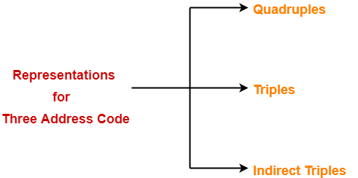
Implementations of 3-address code statements

Slide 37
Implementations of 3-address code statements
Quadruples: It is a record structure with 4 fields.
(op, arg1, arg2, result)
Here-
The op field is used for storing the internal code of the operator.
The arg1 and arg2 fields are used for storing the two operands used.
The result field is used for storing the result of the expression.
Example:
-To represent the statement x = y op z, we place-
op in the operator field,y in the arg1 field,z in the arg2 field,x in the result field.
-To represent the statement x = op y, we place-
op in the operator field,y in the arg1 field,x in the result field,arg2 field remains unused.
-To represent the statement like param t1, we place-
param in the operator field,t1 in the arg1 field,Neither arg2 field nor result field is used.
-To represent the unconditional and conditional jump statements, we place label of the target in the result field.
Triples: It is a record structure with 3 fields.
(op, arg1, arg2)
In triples representation,
References to the instructions are made.
Temporary variables are not used.
Indirect triples:
Listing the pointers to the triples rather
than listing the triples themselves are
called indirect triples.

Slide 38
Translate the following expression to quadruple, triple and indirect triples
a = b * – c + b * – c
Quadruples
Triples
Three address code:
t₁=- c
t₂=b * t₁
t₃=- c
t₄=b * t₃
t₅=t₂ + t₄
a=t₅
 | op | arg1 | arg2 | result
(0) | uminus | c |  | t₁
(1) | * | b | t₁ | t₂
(2) | uminus | c |  | t₃
(3) | * | b | t₃ | t₄
(4) | + | t₂ | t₄ | t₅
(5) | = | t₅ |  | a
 | op | arg1 | arg2
(0) | uminus | c
(1) | * | b | (0)
(2) | uminus | c
(3) | * | b | (2)
(4) | + | (1) | (3)
(5) | = | a | (4)
 | op
(0) | (14)
(1) | (15)
(2) | (16)
(3) | (17)
(4) | (18)
(5) | (19)
 | op | arg1 | arg2
(14) | uminus | c
(15) | * | b | (14)
(16) | uminus | c
(17) | * | b | (16)
(18) | + | (15) | (17)
(19) | = | a | (18)
Indirect triples

Slide 39
Translate the following expression to quadruples and triples
-(a+b)*(c+d)+(a+b+c)
Quadruples
Triples
Three address code:
t₁=a+b
t₂=c+d
t₃=a+b
t₄=t₃+c
t₅=-t₁
t₆=t₅*t₂
t₇=t₆+t₄
 | op | arg1 | arg2 | result
(0) | + | a | b | t₁
(1) | + | c | d | t₂
(2) | + | a | b | t₃
(3) | + | t₃ | c | t₄
(4) | - | t₁ |  | t₅
(5) | * | t₅ | t₂ | t₆
(6) | + | t₆ | t₄ | t₇
 | op | arg1 | arg2
(0) | + | a | b
(1) | + | c | d
(2) | + | a | b
(3) | + | (2) | c
(4) | - | (0)
(5) | * | (4) | (1)
(6) | + | (5) | (3)

Slide 40
Translate the following expression to quadruples and triples
1) x=(a+b)*-c/d 2) a + b x c / e ↑ f + b x a
x=(a+b)*-c/d
Three address code:
t₁=a+b
t₂=-c
t₃=t₁*t₂
t₄=t₃/d
x=t₄
a + b x c / e ↑ f + b x a
Three address code:
T1 = e ↑ f
T2 = b x c
T3 = T2 / T1
T4 = b x a
T5 = a + T3
T6 = T5 + T4

Slide 41
Construct triples for a*-(b+c)
Three address code:
t₁=b+c
t₂=-t₁
t₃=a*t2
Triples
 | op | arg1 | arg2
(0) | + | b | c
(1) | - | (0)
(2) | * | a | (1)

Slide 42
Other types of 3-address statements
e.g. ternary operations like x[i]:=y x:=y[i]
require two or more entries. e.g.
 | op | arg1 | arg2
(0) | [ ] = | x | i
(1) | assign | (0) | y
 | op | arg1 | arg2
(0) | [ ] = | y | i
(1) | assign | x | (0)

Slide 43
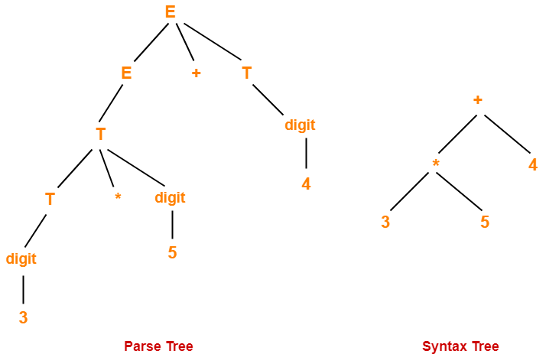
Syntax Tree
Syntax trees are abstract or compact representation of parse trees.They are also called as Abstract Syntax Trees.
Syntax tree is the compact form of a parse tree.
Each interior node represents an operator.
Each leaf node represents an operand.

Slide 44
Construction of Syntax Tree
Constructing syntax tree for an expression is similar to the translation of the expression into postfix form.
The following functions are used in syntax tree for the expression.
1. mknode ( op, left, right ) This function creates a node with the field operator having operator as label, and the two pointers to left and right.
2. mkleaf ( id, entry ) This function creates an identifier node with label “id” and a pointer to symbol table is given by “entry”.
3. mkleaf ( num, val ) This function creates a node for number with label “num” and “val” is for the value of that number.

Slide 45
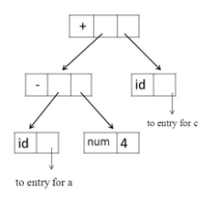
Example
Construct Syntax Tree for a- 4 + c
Postfix Form: a4-c+
P1 = mkleaf(id, entry a)
P2 = mkleaf(num, 4)
P3 = mknode(-, P1 , P2 )
P4 = mkleaf(id, entry c)
P5 = mknode(+, P3 , P4 )
Where P1,P2…P5 are pointers to the nodes.
Tree is constructed from Bootom-Up.

Slide 46
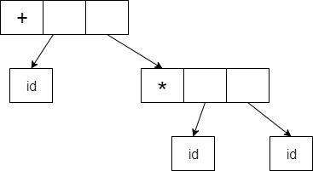

Example
Construct Syntax Tree for a+b*c
Postfix Form: abc*+
P1 = mkleaf(id, entry a)
P2 = mkleaf(id, entry b)
P3 = mkleaf(id, entry c)
P4 = mknode(*, P2 , P3 )
P5 = mknode(+, P1 , P4 )
Where P1,P2…P5 are pointers to the nodes.
Tree is constructed from Bootom-Up.
entry for a
entry for b
entry for c

Slide 47
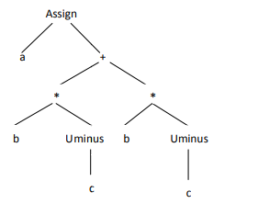
Construct a syntax tree for the following arithmetic expression
a=b*-c+b*-c
We convert the given arithmetic expression into a postfix expression as-
abc-*bc-*+=

Slide 48
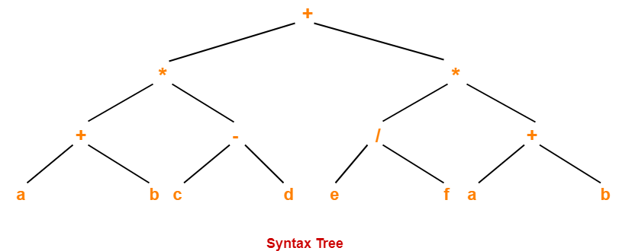
Construct a syntax tree for the following arithmetic expression
( a + b ) * ( c – d ) + ( ( e / f ) * ( a + b ))
We convert the given arithmetic expression into a postfix expression as-
( a + b ) * ( c – d ) + ( ( e / f ) * ( a + b ) )
( a + b ) * ( c – d ) + ( ( e f/) * ( a + b ) )
( a + b ) * ( c – d ) + ( ( e f/ ) * ( ab+ ) )
( a + b ) * ( c – d ) + (ef/ab+*)
ab+ * ( c – d ) + (ef/ab+*)
(ab+) * (cd- )+ (ef/ab+*)
(ab+cd-*) + (ef/ab+*)
ab+cd-*ef/ab+*+

Slide 49
SDD for constructing Syntax tree
E
E + T
E → E₁ + T {E.nptr=mknode(‘+’,E₁.nptr,T.nprt }
E → T { E.nptr=T.nptr}
T → T₁ * F {T.nptr=mknode(‘*’,T₁.nptr,F.nprt }
T → F {T.nptr=F.nptr }
F → (E) { F.nptr=E.nptr}
F → id {F.nptr=mkleaf(id,id.entry}
F → num {F.nptr=mkleaf(num,num.val)}
Example: 2+3*4
T T * F
F F num
4
num num
2 3

Slide 50
Types and Declarations
Type Expressions
Type Equivalence

Slide 51
Type Expression
Type expression will denotes the type of a language construct.
A type expression can be:
A basic type
a primitive data type such as integer, real, char, boolean, …
type-error to signal a type error
void : no type
A type name
a name can be used to denote a type expression.
A type constructor applies to other type expressions.
arrays: If T is a type expression, then array(I,T) is a type expression where I denotes index range.
Ex: array(0..99,int)
products: If T₁ and T₂ are type expressions, then their cartesian product T₁ X T₂ is a type expression.
Ex: int x int
records: It will be applied to field names and field types. struct student{ int no; char name[10]; }
then record( (no X int) X (name X array(0..9,char)) )
pointers: If T is a type expression, then pointer(T) is a type expression.
Ex: pointer(int)
functions: We may treat functions in a programming language as mapping from a domain type D to a range type R. So, the type of a function can be denoted by the type expression D→R where D are R type expressions.
Ex: int→int represents the type of a function which takes an int value as parameter, and its return type is also int.

Slide 52
Type System
It is a collection of rules for assigning type expression.
Components of type system:
-Basic Type
-Type constructor
-Type Equivalence Name equivalence Ex: char a,b;
a=‘A’;
b=a;
Structural Equivalence Ex: struct a,b;

Slide 53
Type Equivalence
When type expressions are represented by graphs, two types are structurally equivalent if and only if one of the following conditions is true:
They are the same basic type.
They are formed by applying the same constructor to structurally equivalent types.
One is a type name that denotes the other.
Name-equivalent expressions are assigned the same value number.

Slide 54
Type Checking
A compiler has to do semantic checks in addition to syntactic checks.
Semantic Checks
Static – done during compilation
Dynamic – done during run-time(division by zero)
Type checking is one of these static checking operations.
we may not do all type checking at compile-time.
Some systems also use dynamic type checking too.

Slide 55
Type Checking
Type checking is the process of verifying that each operation executed in a program respects the type system of the language.
-This generally means that all operands in any expression are of appropriate types and number.
For example : x = a % b;
– % operation requirement is that both of the operands must be of the same type of integer
– If one is integer and another is of some other data type, it means that % operation is applied to incompatible operands.
Types of type checking:
Static – done during compilation
Dynamic – done during run-time

Slide 56
Static type checking
Static type checking is done at compile-time.
The information the type checker needs is obtained via declarations and stored in a master symbol table.
After this information is collected, the types involved in each operation are checked.
Types(Examples) of Static Checks:
Type Checks
Flow of Control Checks
Uniqueness Checks
Name-related Checks

Slide 57
Type Checks:
– To make it sure that the operator is applied to compatible operands
– A Compiler must report an error if an operator is applied to incompatible operands
– For example : An integer variable is added with a character variable
Flow of control checking:
– Checking of branching statements
• GOTO, BREAK, and CONTINUE etc.
• If branching location exists or not
– If it does not exist, then error is reported
Uniqueness Checking:
– Make it sure unique declaration of variable in a scope
– No two variables with the same name in a scope
– labels in a case statement must be distinct.
Name related checks:
– If the same name appears both in the beginning and the ending of a construct
– It is the duty of compiler to make it sure that the same name appears at both the places
– Example: When a function has to be called, the same name is used at both the places.

Slide 58
Dynamic type checking
Implemented by including type information for each data location at runtime.
For example,division by zero.
Another example is array out of bound

Slide 59
A Simple Type Checking System
P → D;E
D → D;D
D → id:T { addtype(id.entry,T.type) }
T → char { T.type=char }
T → int { T.type=int }
T → real { T.type=real }
T → ↑T₁ { T.type=pointer(T₁.type) }
T → array[intnum] of T₁ { T.type=array(1..intnum.val,T₁.type) }

Slide 60
Type Checking of Expressions
E → id { E.type=lookup(id.entry) }
E → charliteral { E.type=char }
E → intliteral { E.type=int }
E → realliteral { E.type=real }
E → E₁ + E₂ { if (E₁.type=int and E₂.type=int) then E.type=int
else if (E₁.type=int and E₂.type=real) then E.type=real
else if (E₁.type=real and E₂.type=int) then E.type=real
else if (E₁.type=real and E₂.type=real) then E.type=real
else E.type=type-error }
E → E₁ [E₂] { if (E₂.type=int and E₁.type=array(s,t)) then E.type=t
else E.type=type-error }
E → E₁ ↑ { if (E₁.type=pointer(t)) then E.type=t
else E.type=type-error }

Slide 61
Type Checking of Statements
S ->if E then S1 { if (E.type=boolean then S.type=S1.type
else S.type=type-error }
S->while E do S1 { if (E.type=boolean then S.type=S1.type
else S.type=type-error }

Slide 62
Type Conversion
Implicit Conversion(Coercion): automatically done by compiler.
char c=‘a’;
int d=c; => d=97
Type Checking Rules for Coercion from integer to real:
Explicit Conversion(Type Casting): force type conversion.
a=(int)12.3 => a=12
E → id { E.type=lookup(id.entry) }
E → num { E.type=int }
E → num.num { E.type=real }
E → E₁ + E₂ { if (E₁.type=int and E₂.type=int) then E.type=int
else if (E₁.type=int and E₂.type=real) then E.type=real
else if (E₁.type=real and E₂.type=int) then E.type=real
else if (E₁.type=real and E₂.type=real) then E.type=real
else E.type=type-error }

Slide 63
Storage Organization
Run-Time Memory
Storage Allocation Strategies

Slide 64
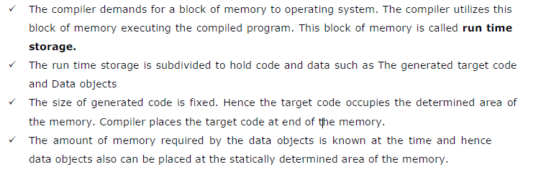
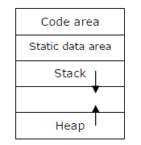
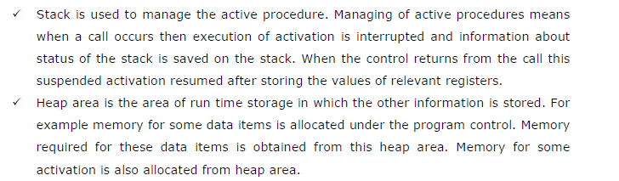
Runtime Memory

Slide 65
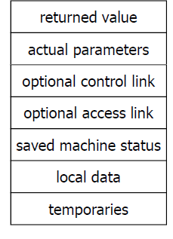
Activation Record
Information needed by a single execution of a procedure is managed using an activation record or frame
Temporary values
Ex. those arising in the evaluation of
expressions
Local data
Data that is local to an execution of the
Procedure
Saved machine status
State of the machine info before
procedure is called. Values of program
counter and machine registers that have
to be restored when control returns from
the procedure
Access Link
refer to non-local data held in other
activation records
Control link
points to the activation record of the caller
Actual parameters
used by the calling procedure to supply
parameters to the called procedure
(in practice these are passed in registers)
Returned value
used by the called procedure to return a
value to the calling procedure
(in practice it is returned in a register)

Slide 66
Storage Allocation Strategies
The various storage allocation strategies to allocate storage in different data areas of memory are:
Static Allocation
• Storage is allocated for all data objects at compile time
Stack Allocation
• The storage is managed as a stack
Heap Allocation (It is one of Dynamic Storage Allocation)
• The storage is allocated and deallocated at runtime from a
data area known as heap

Slide 67
Static Allocation
In a static environment there are a number of restrictions:
Size of data objects are known at compile time
No recursive procedures
No dynamic memory allocation
Only one copy of each procedure activation record exists at time t
We can allocate storage at compile time
• Bindings do not change at runtime
• Every time a procedure is called, the same bindings occur

Slide 68
Static Allocation
Statically allocated names are bound to relocatable storage at compile time.
Storage bindings of statically allocated names never change.
The compiler uses the type of a name (retrieved from the symbol table) to determine storage size required.
The required number of bytes (possibly aligned) is set aside for the name.
The relocatable address of the storage is fixed at compile time.

Slide 69
Static Allocation
Limitations:
The size required must be known at compile time.
Recursive procedures cannot be implemented statically.
No data structure can be created dynamically as all data is static.

Slide 70
Stack Allocation
In a stack-based allocation, the previous restrictions are lifted
procedures are allowed to be called recursively
Need to hold multiple activation records for the same procedure
Created as required and placed on the stack
Each record will maintain a pointer to the record that activated it
On completion, the current record will be deleted from the stack and control is passed to the calling record
Dynamic memory allocation is allowed
Pointers to data locations are allowed

Slide 71
Stack Allocation
Storage is organized as a stack.
Activation records are pushed and popped.
Locals and parameters are contained in the activation records for the call.
This means locals are bound to fresh storage on every call.
We just need a stack_top pointer.
To allocate a new activation record, we just increase stack_top.
To deallocate an existing activation record, we just decrease stack_top.

Slide 72
Heap Allocation
Stack allocation cannot be used if:
The values of the local variables must be retained when an activation ends
A called activation outlives the caller
In such a case de-allocation of activation record cannot occur in last-in first-out fashion
Heap allocation gives out pieces of contiguous storage for activation records

Slide 73
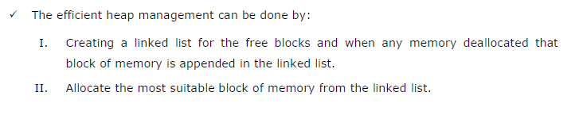
Heap Allocation
Heap allocation parcels out pieces of contiguous storage, as needed for activation records or other objects. Pieces may be deallocated in any order, so over the time the heap will consist of alternate areas that are free and in use.
Heap allocation retains the activation record even after the activation is completed.Later when it is deallocated the free space left out will be filled by the heap manager for some other objects.

Slide 74
Symbol Table
A symbol table is a necessary component because
Declaration of identifiers appears once in a program
Use of identifiers may appear in many places of the program text
Symbol tables are data structures that are used by compilers to hold information about source-program constructs.

Slide 75
INFORMATION PROVIDED BY SYMBOL TABLE
Given an Identifier which name is it?
What information is to be associated with a name?
How do we access this information?

Slide 76
SYMBOL TABLE - NAMES
Variable and labels
Parameter
Constant
NAME
Record
RecordField
Procedure
Array and files

Slide 77
SYMBOL TABLE-ATTRIBUTES
Each piece of information associated with a name is called an attribute.
Attributes are language dependent.
Different classes of Symbols have different Attributes
Variable, Constants
Type , Line number where declared , Lines where referenced , Scope
Procedure or function
Number of parameters, parameters themselves, result type.
Array
# of Dimensions, Array bounds.

Slide 78
USE OF SYMBOL TABLE
Symbol table information is used by the analysis and synthesis phases
To verify that used identifiers have been defined (declared)
To verify that expressions and assignments are semantically correct – type checking
To generate intermediate or target code

Slide 79
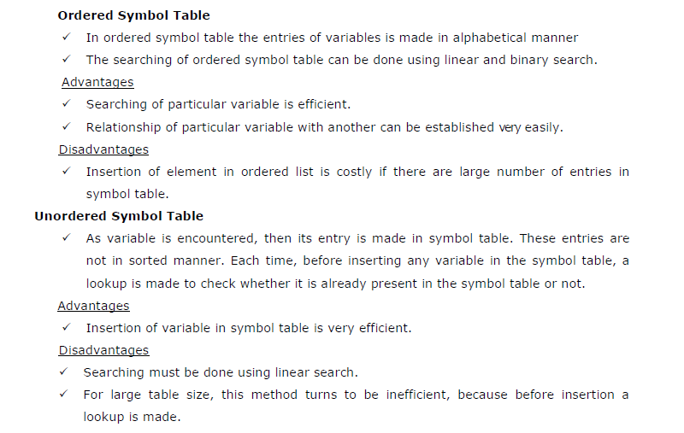
Ordered and Unordered Symbol Table

Slide 80
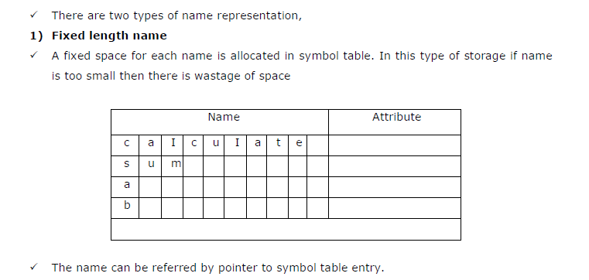

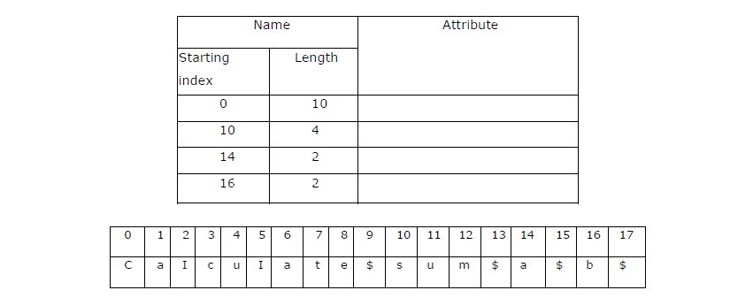

Slide 81
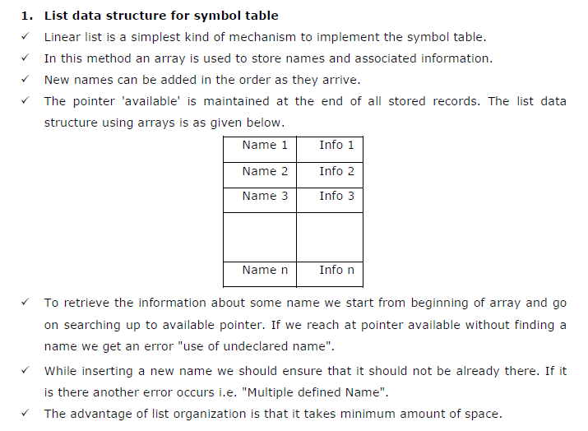
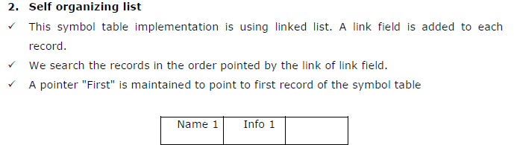
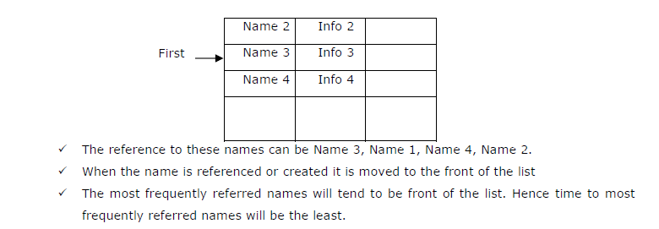

Slide 82
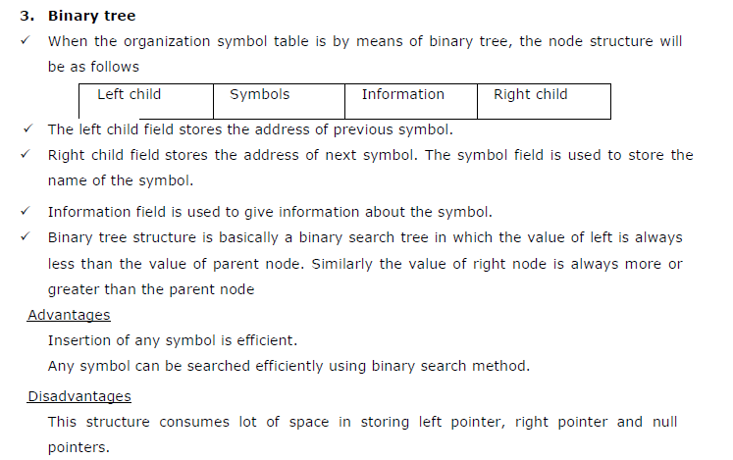
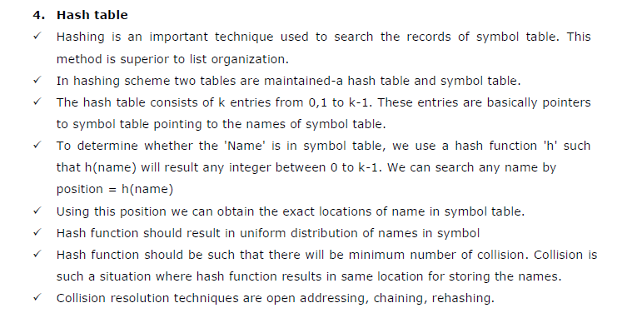


Slide 83
Any Queries?

